Slide 1
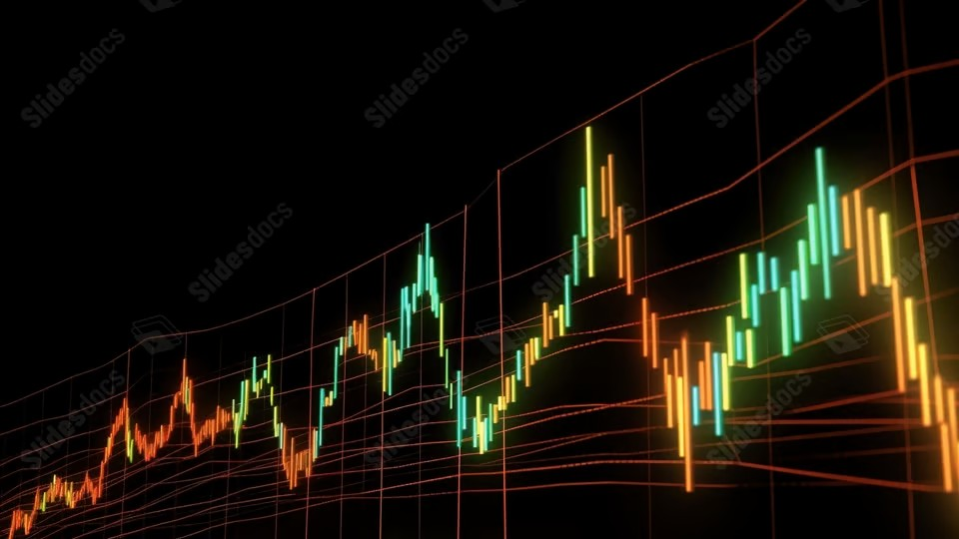
Portfolio Performance Overview
Last updated on the 30 December 2025 at 09:40 PM

Slide 2
Trade Plan and Brokerage Overview
Total Portfolio: $101,801.49 Total Brokerage: $99.00 Net Invested: $102,036.20
Security | Current | Target | Change | Last Price | Brokerage | Cash Flow
A200 | 21 | 21 | 0 | $146.29 | $0.00 | $0.00
IEU | 97 | 97 | 0 | $101.27 | $0.00 | $0.00
IJP | 7 | 6 | -1 | $120.25 | $11.00 | -$120.25
IOO | 44 | 43 | -1 | $187.60 | $11.00 | -$187.60
IVV | 104 | 103 | -1 | $68.49 | $11.00 | -$68.49
MTUM | 21 | 25 | 4 | $29.07 | $11.00 | $116.28
MVW | 55 | 55 | 0 | $38.76 | $0.00 | $0.00
QHAL | 55 | 55 | 0 | $53.39 | $0.00 | $0.00
QLTY | 165 | 165 | 0 | $33.10 | $0.00 | $0.00
QUAL | 84 | 83 | -1 | $61.94 | $11.00 | -$61.94
SMH | 1 | 1 | 0 | $542.64 | $0.00 | $0.00
Security | Current | Target | Change | Last Price | Brokerage | Cash Flow
SMLL | 1115 | 1117 | 2 | $4.72 | $0.00 | $9.44
SPY | 1 | 1 | 0 | $1,024.83 | $0.00 | $0.00
VAS | 27 | 27 | 0 | $109.01 | $0.00 | $0.00
VDHG | 102 | 103 | 1 | $74.37 | $11.00 | $74.37
VGE | 98 | 98 | 0 | $89.86 | $0.00 | $0.00
VGS | 56 | 55 | -1 | $153.90 | $11.00 | -$153.90
VLU | 0 | 0 | 0 | $316.04 | $0.00 | $0.00
VLUE | 190 | 189 | -1 | $33.54 | $11.00 | -$33.54
VMIN | 113 | 116 | 3 | $63.64 | $11.00 | $190.92
VSO | 66 | 66 | 0 | $77.99 | $0.00 | $0.00
VVLU | 41 | 41 | 0 | $80.93 | $0.00 | $0.00
Cash: -235 AUD

Slide 3
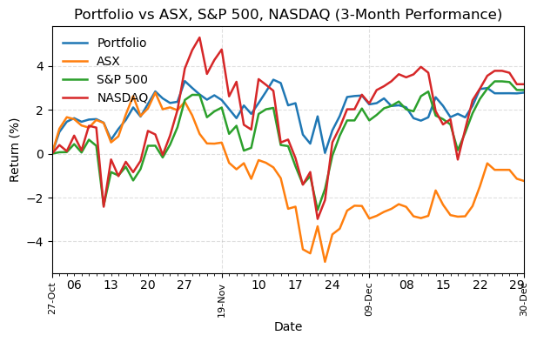
Portfolio Performance
Return Summary
 | 3M | 6M | 12M | 3Y
Portfolio | 2.98% | 9.72% | 15.66% | 39.02%
ASX | -1.27% | 3.30% | 6.01% | 25.49%
S&P 500 | 3.67% | 11.87% | 15.66% | 79.40%
NASDAQ | 3.91% | 15.79% | 19.03% | 124.03%

Slide 4
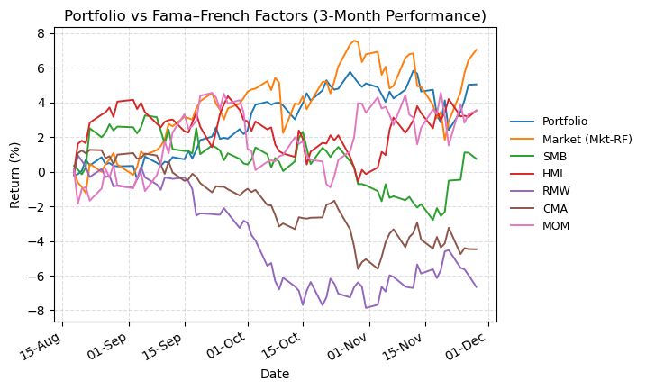
Fama–French Benchmarks vs Portfolio
Return Summary
 | 3M | 6M | 12M | 3Y
Portfolio | 4.51% | 12.73% | 18.06% | 38.49%
Market (Mkt-RF) | 6.29% | 17.25% | 15.43% | 48.96%
SMB | -1.94% | 1.93% | -10.60% | -16.82%
HML | -0.17% | 0.77% | 0.17% | -5.00%
RMW | -6.44% | -9.65% | -9.85% | -8.55%
CMA | -5.33% | -4.00% | -5.63% | -12.92%
MOM | 3.86% | 1.22% | 4.86% | 30.01%

Slide 5
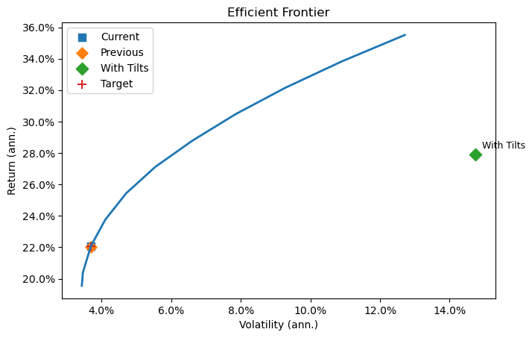
Efficient Frontier
Point | Vol (ann.) | Return (ann.)
Current | 3.69% | 22.08%
Previous | 3.68% | 22.02%
With Tilts | 14.69% | 27.84%
Target | 3.69% | 22.07%
Factor | With Tilts | Without Tilts | Target | With - Target | Without - Target
Mkt-RF | 0.686 | 0.049 | 0.886 | -0.200 | -0.837
SMB | -0.039 | -0.002 | -0.027 | -0.012 | 0.025
HML | 0.202 | 0.086 | 0.392 | -0.190 | -0.306
RMW | -0.079 | 0.016 | -0.123 | 0.044 | 0.139
CMA | 0.089 | -0.057 | 0.100 | -0.011 | -0.157
MOM | -0.020 | 0.047 | -0.098 | 0.078 | 0.145

